Slide 1

Module 13 – SMA-X Data Segmentation
Jan 2018
Notes:
[STANDARD SLIDE: L300 (animated)]
You can change out the photo with any image from Getty Images in DropBox.
If the main title is shorter, you can make the font larger.
You may have to move the title text around depending on the photo. Make sure the text is readable against the background photo.
You can change the background color for the rectangle in the bottom-right corner to look better against the background. Choose a Micro Focus color at 25% transparency.
=========================
Note to Narrator or Reader: [PRESS] indicates press the Page Down key to show the animation
=========================
Hello and Welcome to the [COURSE_NAME] Technical Overview Training, Level 300.
In this course you’ll gain a high-level understanding of the essentials of [PRODUCT_NAME].
[PRESS] If you want to download this presentation and save it on your own system, click the Tools & Help icon in the bottom-right corner of your window and select Download.
Or, if you want to access the PPT slides and speaker notes for future reference, go to the Attachments tab in your window click to download the presentation.

Slide 2
Objectives
After completing this module, you should be able to:
Describe the features of Data domain segmentation
Understand differences between Data segmentation and encryption
Configure Data domains and groups
Configure encrypted fields

Slide 3
Data Segmentation

Slide 4
Domain Segmentation
Restricts visibility of records/actions to specific people, roles, or groups
Uses domains to restrict access to records/actions
Request
Incidents
Problems
Changes
Releases
Service Level Targets
Tasks
Approvals
Articles
By default, all records have the Public data domain assigned to them (enabling access to all data domains).
Are different from entitlement rules:
Entitlement rules only apply to a specific set of records (offerings, knowledge articles) in the Self-Service portal.
Domain assignments restrict access to specific records in a user’s view of Service Anywhere.
Notes:
Data domain segmentation in SMA-X provides the ability to restrict the visibility of specific records and actions (such as tasks and approvals) to specific people, roles, or groups. Data domain segmentation is composed of two parts:
Assignment of permissions to view particular data domains to a person, role, or group. The automatic assignment of permissions to view a specific data domain is best done by selecting a Primary data domain for a group or user.
Assignment of data domains to records. The automatic assignment of data domains to records as a result of out-of-the-box business rules running in Service Anywhere is the recommended best practice. Data domains can also be assigned to records manually in specific instances, but this is not recommended as maintenance and automation become much more complicated.
A record must have at least one data domain assigned to it. The Public data domain, enabling access to all data domains, is provided out-of-the-box by SMA-X and is automatically assigned when a record is created, if no other data domain is obtained automatically or selected manually.
All available data domains are listed in the Data domains list in the Lists Management module. Each tenant can have up to 250 data domains. When this limit is reached, the Add button in the List items area is disabled.
There is no option to define the order of the items in the data domains list. New list items are always added to the end of the existing list.
Data domain segmentation in SMA-X is intended to work with minimal manual maintenance.
Edit the out-of-the-box Data domains list in the Lists Management module with the data domains required for your organization.
Assign a Primary data domain for each group.
If necessary, assign permission to people outside a particular group to access a data domain.
After this is set up, you can also assign permission to people outside the group to access the data domain if necessary.

Slide 5


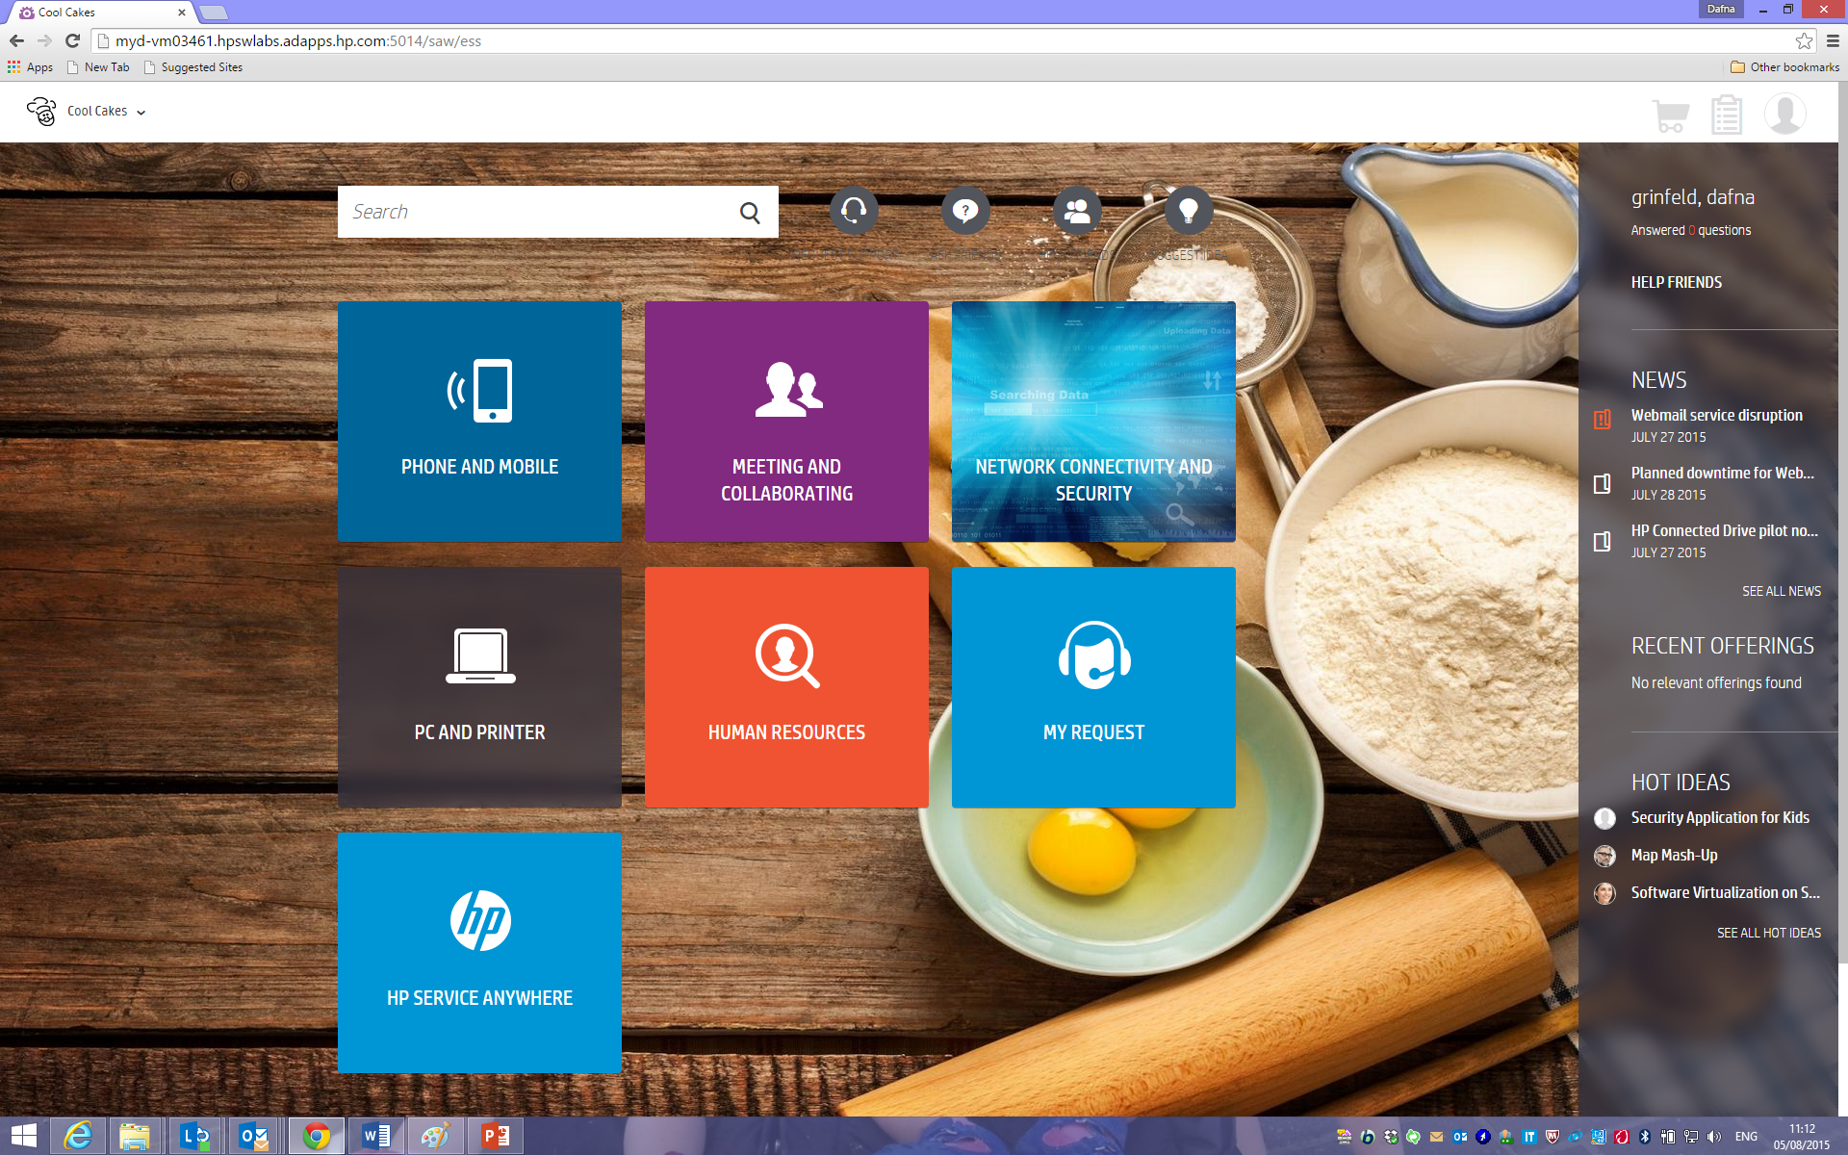
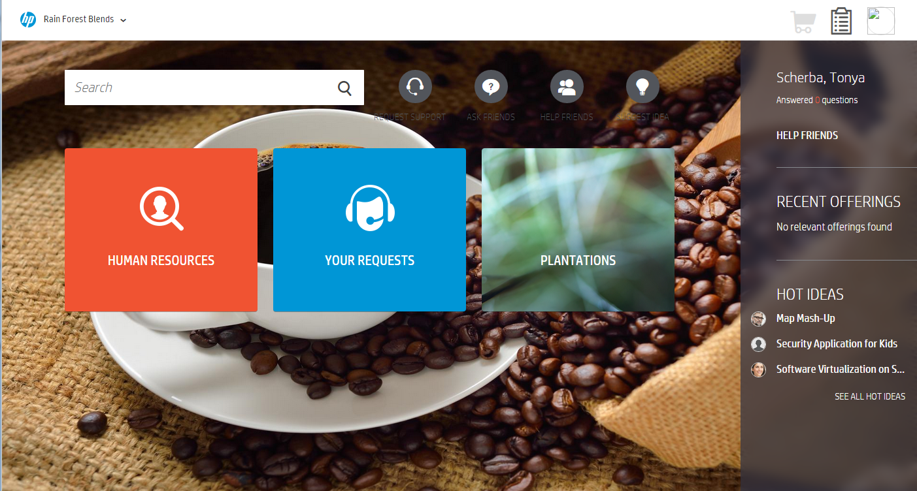


Data and Access Segmentation
1
Data Segmentation
2
White labeling
HR Agent
IT Support Agent
3
Catalog Category entitlement
1
Domain Segmentation
Entitlement Rules
2
3
I need to request Medical Leave
I need Laptops for my Team
I need to request a new Laptop
Employee
Cool Cakes LOB
Employee #2
Rain Forest Blends LOB
Notes:
Data domain assignments are not the same as entitlement rules or white labelling.
Entitlement rules restrict offerings, knowledge articles, service definitions, service catalog categories, and custom themes in the Self-Service Portal to limited audiences in specified locations, and belonging to specified user groups. Entitlement rules apply only to these record types (including articles and offerings) in the Self-Service Portal and fields related to the Self-Service Portal, such as the Catalog offering field in Request records.
White labeling allows to change logo and name of the Agent UI. ESS supports multiple themes, and entitlement is governing which theme a user would see.
Data domain assignments, on the other hand, restrict access to specific records in a user's view in SMA-X
Note that data domain segmentation has no effect on the offerings that an agent is permitted to view. Offerings are visible according to their ownership.
Agents can view all active offerings, but can only request offerings for users who are entitled to them.
Once the catalog offering is requested, the service request is visible to users (agents, expert assignees) based on the domains associated with the service request (the automatic assignment of data domains to records as a result of out-of-the-box business rules running in SMA-X is the recommended best practice).

Slide 6
Domain Segmentation
Use case one: Certain records must not be visible to agents outside the department
HR Agent
IT Support Agent
I need to request special leave
I need Laptops for my Team
Employee
Notes:
Domain segmentation and data segmentation, relate to giving each customer the ability to segregate their own data within their own tenant.
This is important to customers who wish to separate (segregate) sensitive data that should be seen by only certain groups or individuals within their own organization.
It is also important where a company is wanting to support multiple customers within the one tenant, and they want to isolate access for each company whilst having shared service agents manage all customers.

Slide 7
Domains Segmentation
Use case two: Managing few small customers in a single tenant
Shared Service Agents
Login
Login
Tickets
Tickets
Company B Agents
Company A Agents
Company A
User
Company B
User
Notes:
It is also important where a company is wanting to support multiple customers within the one tenant, and they want to isolate access for each company whilst having shared service agents manage all customers.
The use case here is that access to each company data is limited to users from that company but additionally there is a shared service group that can see multiple company’s data

Slide 8
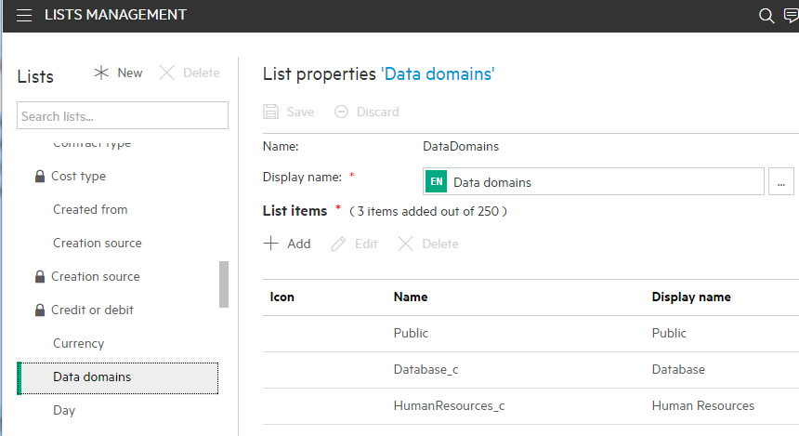
Setup Data Domains
Menu -> Admin -> Lists Management -> Data Domains
Notes:
First step to define data domains is to define domains in Data Domains List (This list could contain up to 250 records per tenant. No sorting is possible – new record will go to the bottom of the list.)

Slide 9
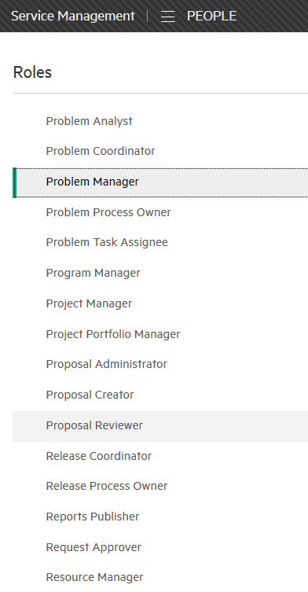
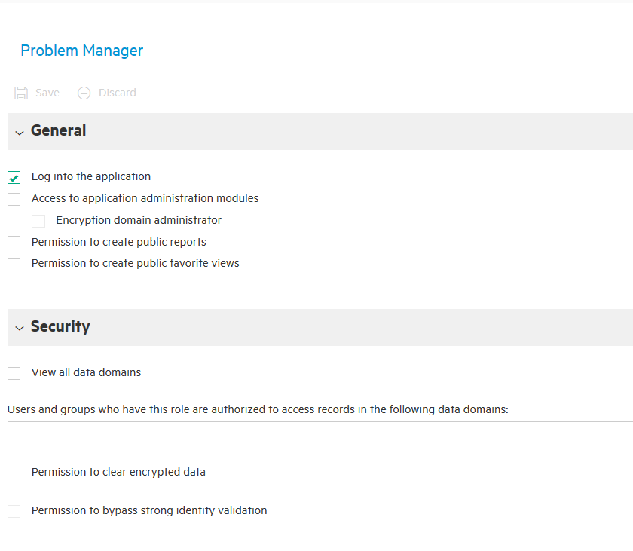
Assignment of permissions to view particular data domains to a person, role, or group
Menu -> Administration > Master Data > People -> Roles
Notes:
Access permissions can be done in a number of ways
Our best practice recommendation is to assign access by groups or roles, but we also allow you to assign permission by user
Domain permissions assigned by roles can allow access to All Domains
or
Limit users with this role to a specific domain or domains

Slide 10
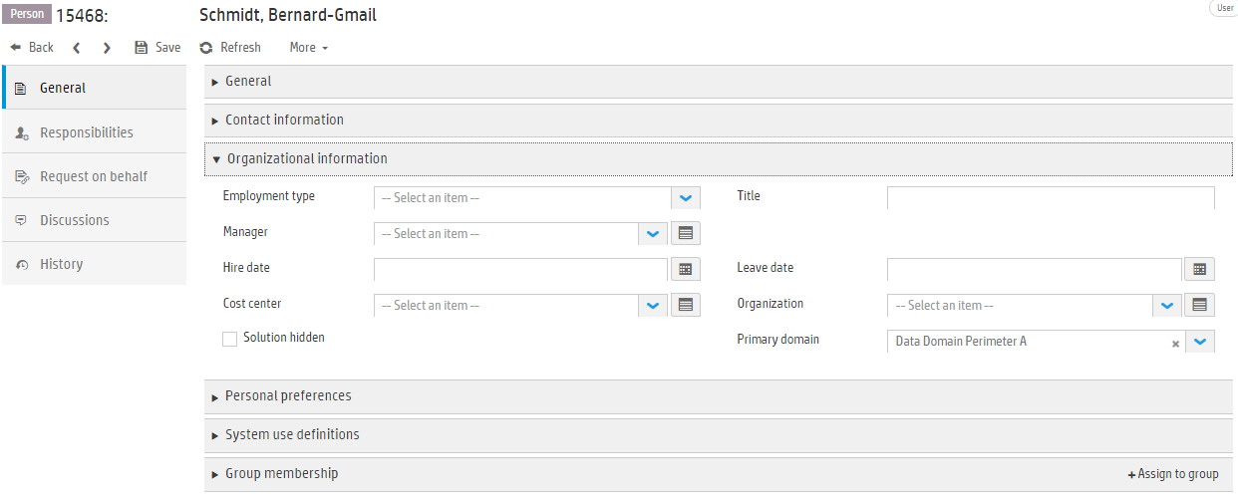
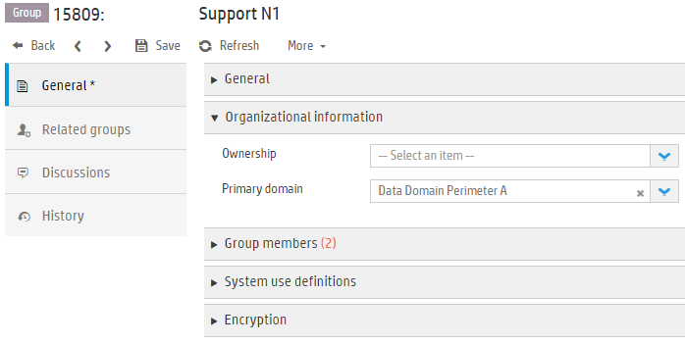
Assignment of data domains to records - Automatically inheriting domains
Based on Groups and/or based on Users
Notes:
The automatic assignment of data domains to records as a result of out-of-the-box business rules running in Service Anywhere is the recommended best practice. Data domains can also be assigned to records manually in specific instances, but this is not recommended as maintenance and automation become much more complicated. For example, when a request is assigned to a particular group, the Primary data domain that is assigned to the group is automatically added to the data domains that are specified for the request, enabling all members of the assignment group to view that request
When you create a record from an existing record, certain information is copied to the new record. For data domain segmentation, the data domain assignment is copied in the following cases:
Creating a change, incident or release from a change.
Creating a change, incident, or problem from an incident.
Creating a change from a problem.
Creating an incident from a request.
If you work with data domains and you want to manually change existing domain assignments, you must first add the Data domains field to the relevant forms

Slide 11
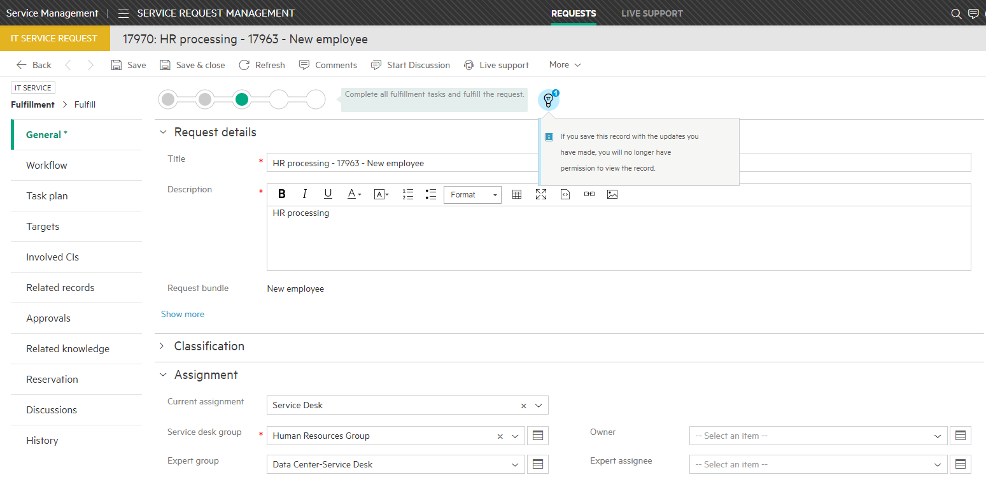
Data Domain can cause “disappearing” records
All records assigned to the data domain are visible only to group members with access to the domain
When a record is assigned or reassigned to this user or group, it will be visible only to groups with access to the domain
Result is records can “disappear”, agent will get a light bulb warning and a message
Notes:
Search results will be limited by data domains assigned to the records. Same will happen with History, Comments of the record.
Tasks and approvals will be also affected with data domains, as reports and hot topic analytics
But Data domain assignment has no effect on items in the Service Portal

Slide 12
Data Encryption

Slide 13
Encryption Domains
Are different from data domains
Are used to encrypt sensitive data and to restrict access to that data so selected users
Require a verification code to view the data in each encryption domain
Notes:
Service Anywhere supports the ability to encrypt specific record type fields via the creation of encryption domains. This enables you to restrict access to sensitive information to selected users.
You can assign groups to an encryption domain; the members of each assigned group will have access to the fields encrypted in that domain. For each user who accesses the encrypted fields, a passcode and a verification code are required.
You can create multiple encryption domains. Each one operates independently. For example, you may want to encrypt sensitive data for changes using Encryption domain 1 and employee data using Encryption domain 2. Each encryption domain requires a separate verification code. (One passcode is valid for all encryption domains.)
Encryption domains are not supported in the Dev2Prod functionality. Any encryption domains defined in your development environment must be manually redefined in your production environment.
Encryption domains are not related to data domains.
Encryption domain administrator permission is required to create or update encryption domains.
For detailed information about managing encryption domains, read the Administration → People → Encryption domains topic in the Help Server.

Slide 14
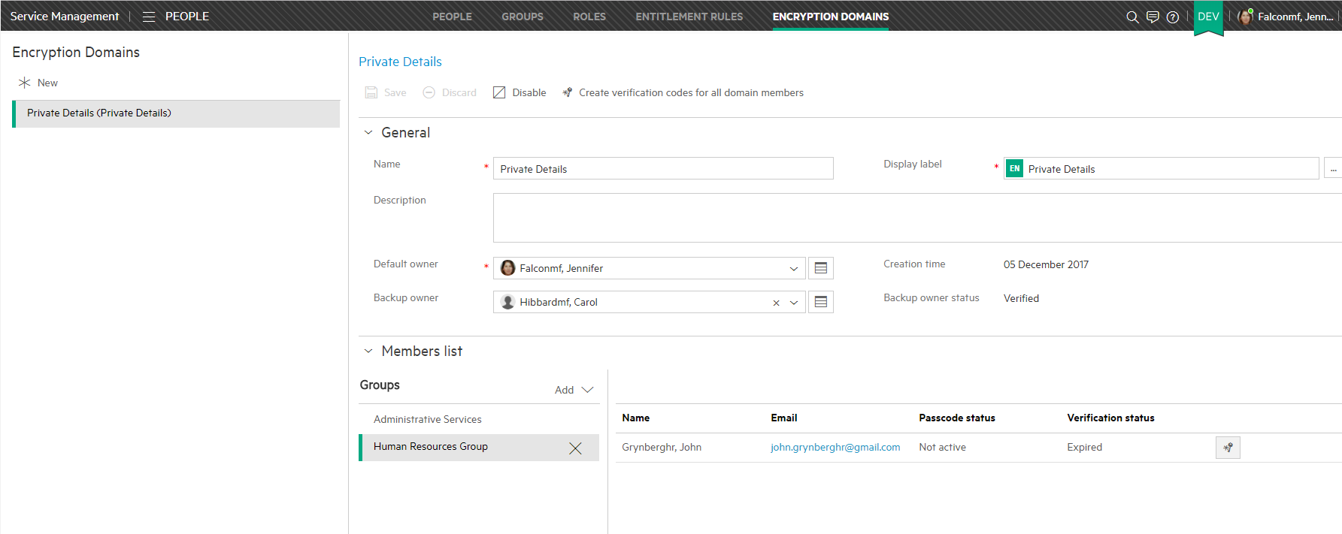
Encryption Domain review
1. Create Encryption Domain and add groups to the domain

Slide 15
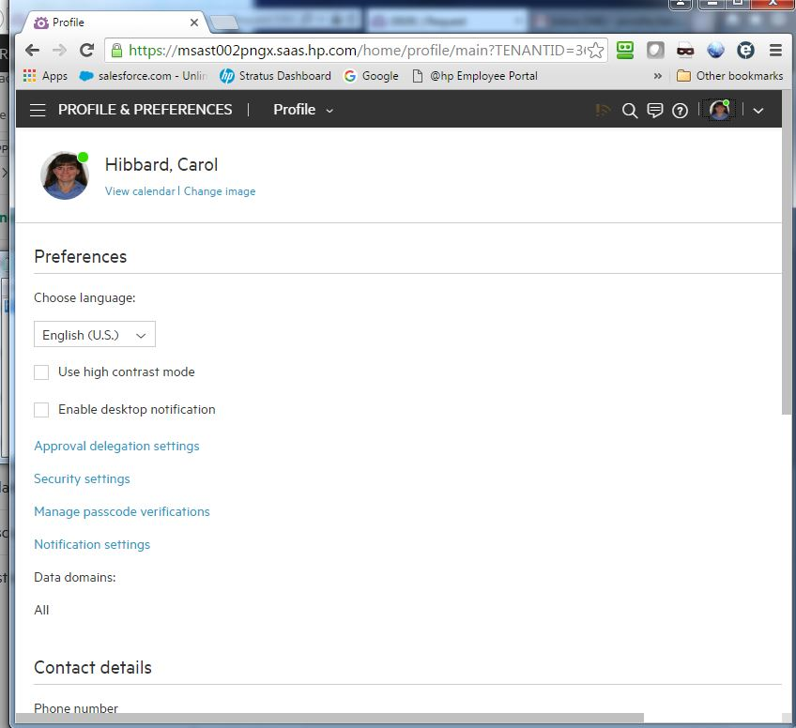
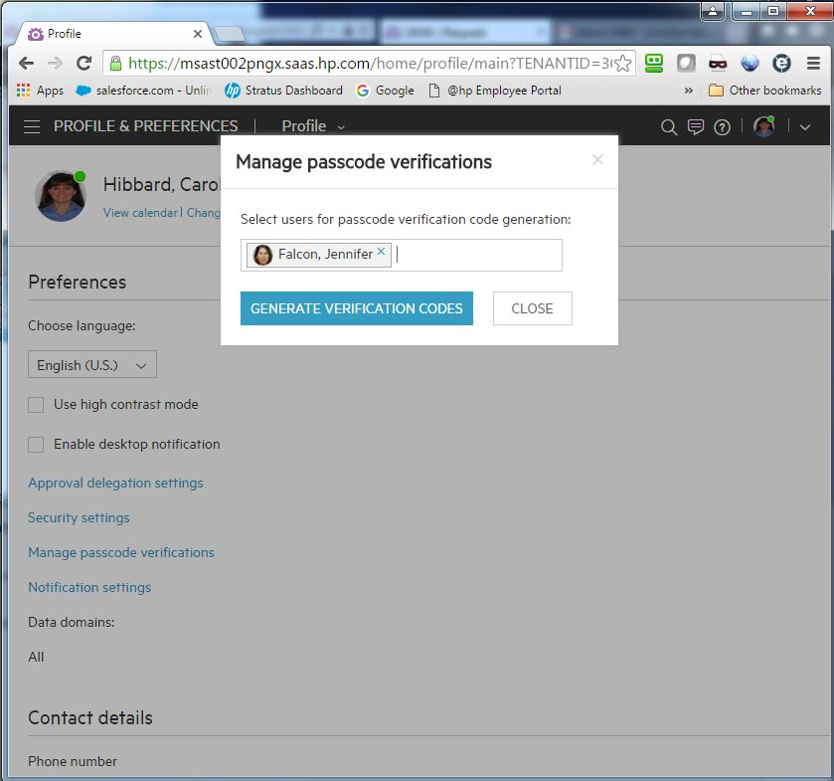
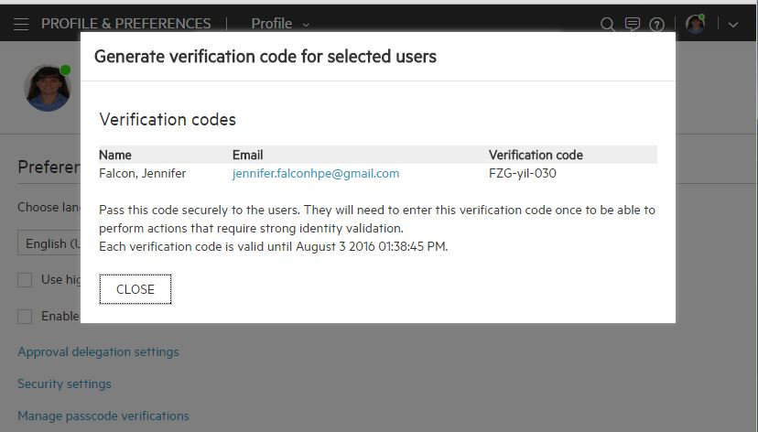
2. Generate verification codes for user passcodes
Verifier goes to his Profile and Preferences page by clicking on his avatar

Slide 16
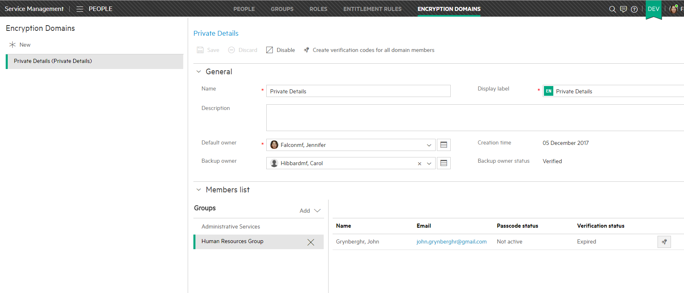
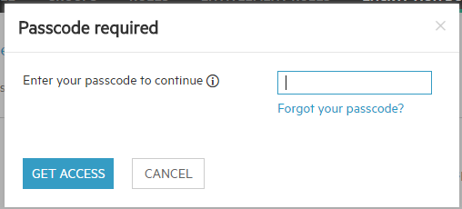
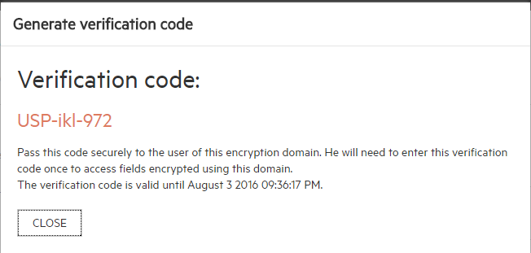
3. Generate verification codes for users of encryption domain
and then share both verification codes with user

Slide 17
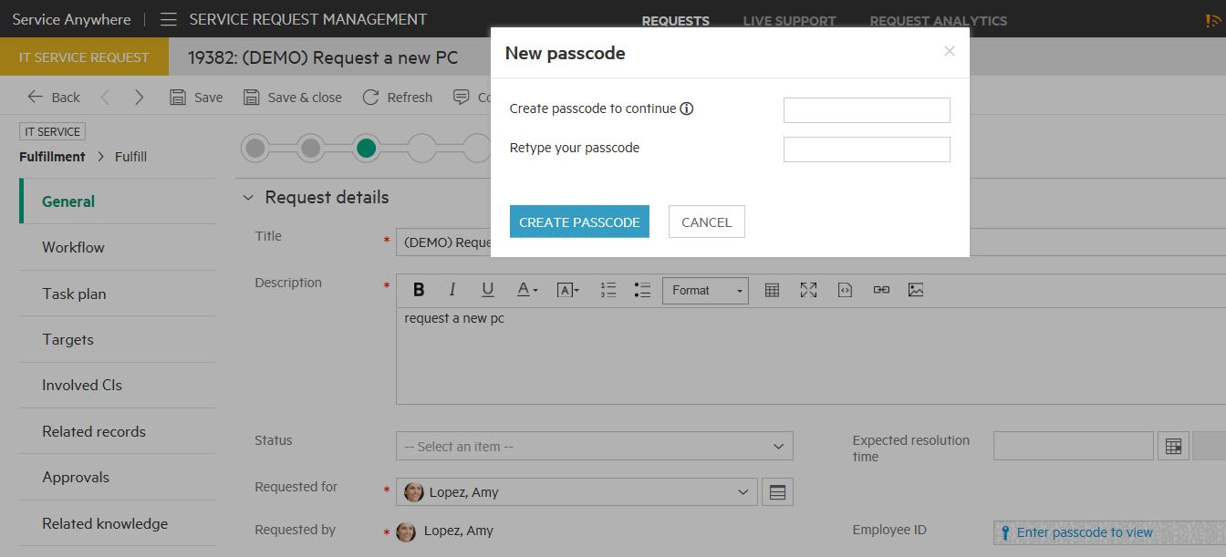
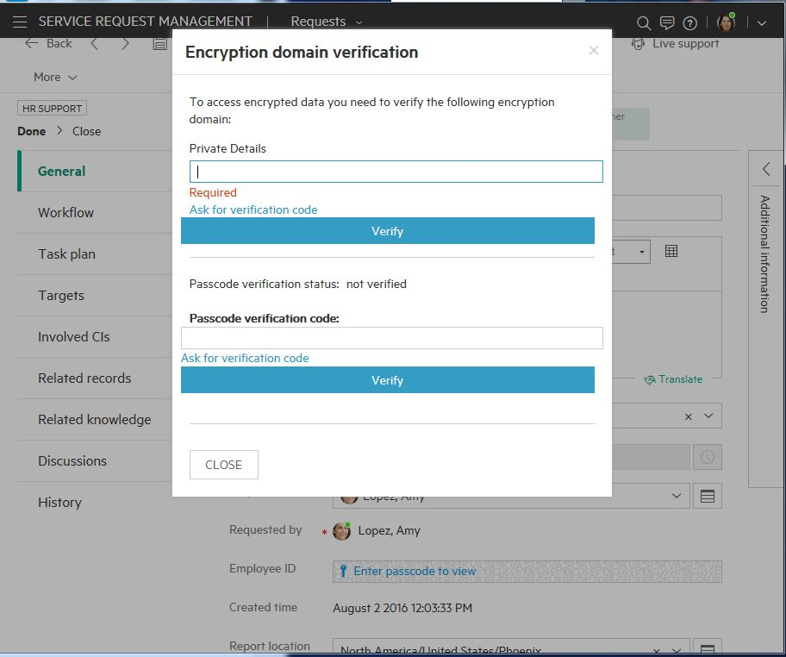
Encryption Domain review
4. User creates passcode
5. User enters encryption domain verification code and passcode verification code (provided by verifier) the first time

Slide 18
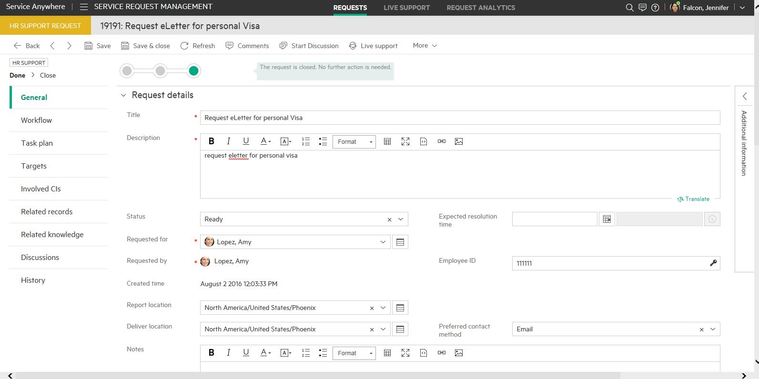
6. User gets visibility to encrypted field contents (decrypted)

Slide 19
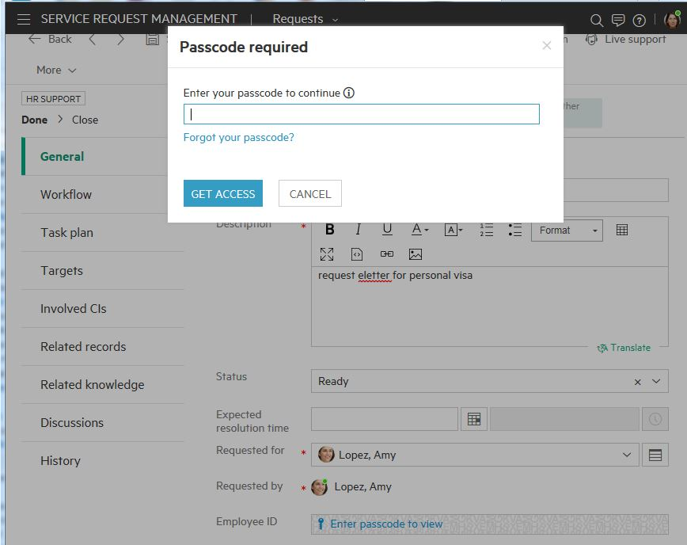
Passcode only required thereafter

Slide 20
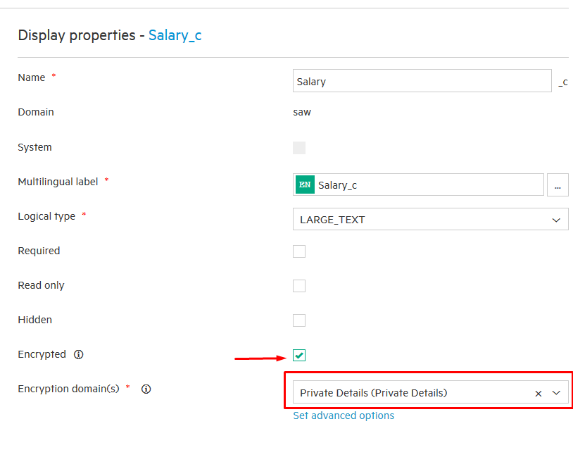
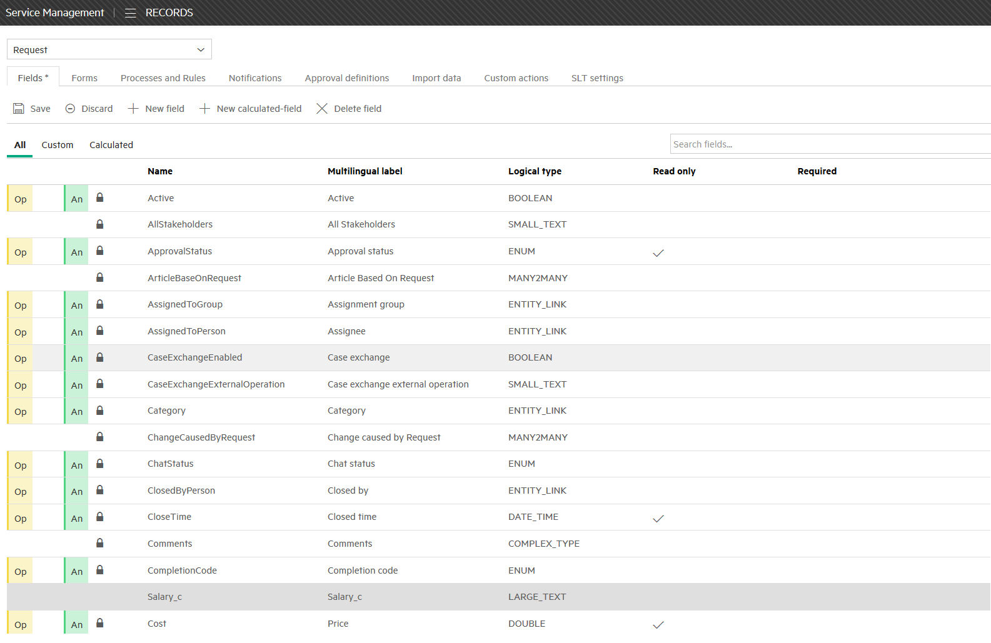
Field Level Encryption
Steps to setup field encryption
Create and configure encryption domain
Create and store encryption keys
Create verification codes for all domain members
Chose (or create) field and mark as encrypted
5. Add field to form
Notes:
NOTE Field type restrictions for encryption MEDIUM_TEXT, LARGE_TEXT, or RICH_TEXT.

Slide 21
Lab
Practice the Demo segmentation card

Slide 22


Lab Exercises

